Slide 1

PYFAANG Stock Analysis
Pei-Ju Wu (Emily)
UC Berkeley Bootcamp

Slide 2
Introduction & objectives
Analyze FAANG stock data from 2012 to 2022. Gain insights into price trends, trading volumes, and market capitalization. Compare performance to the S&P 500 index. Provide investment recommendations based on risk profiles.

Slide 3

Data sources & DATA PROCESS & VISUALIZATION
YAHOO-FIN PYTHON OPEN-SOURCE LIBRARY
ALPHA VANTAGE API
PANDAS
MATPLOTLIB
SEABORN

Slide 4
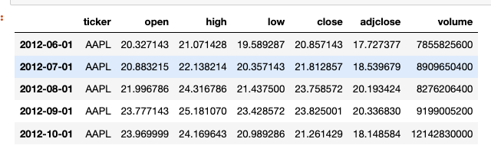
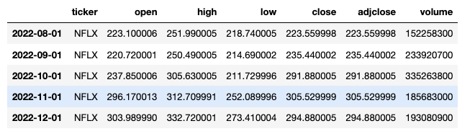
DATA FECTHING
The FAANG stock data covers 10 years on a monthly basis, starting from June 1, 2012, after the IPO of Meta in May 2012.
It includes monthly open, close, high, low prices, adjusted close prices, and trading volume.
Notes:
- adjusted close prices accounting for stock splits, dividends, and other corporate actions.

Slide 5
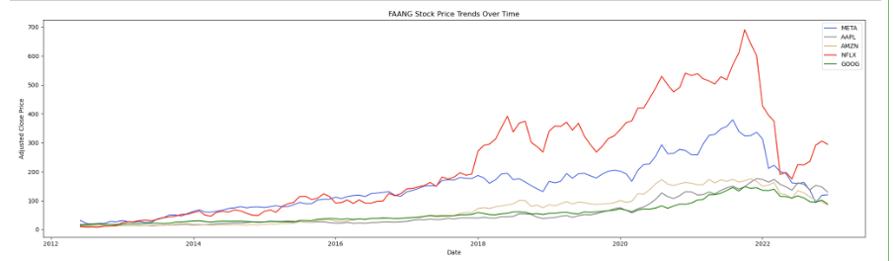
Price trends
The trend for FAANG companies shows a consistent increase in stock prices over the analyzed period.
Notes:
Add logo?

Slide 6
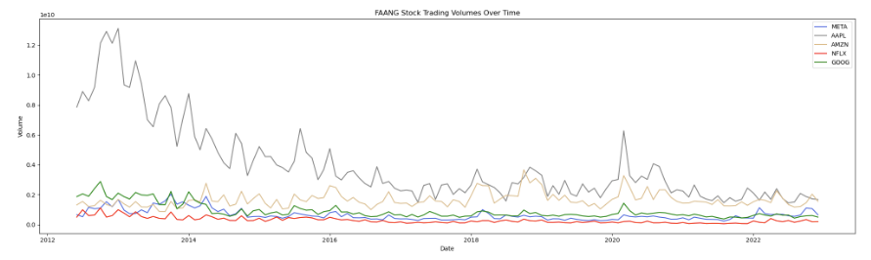
Trading volumes
Overall, there was a decrease in the trading volume trend. However, in the years of 2018 and 2020, there was a notable increase in trading volumes.
Notes:
Add logo?
From 2012 to 2022, the dataset reveals a pattern where the FAANG stock prices were increasing while the trading volumes were decreasing before 2020, suggesting a potential "reduction of market participation" and a potential indication of a price reversal. Now, let's dive deeper into the dataset to examine the dynamics of the FAANG stocks during the pandemic.

Slide 7
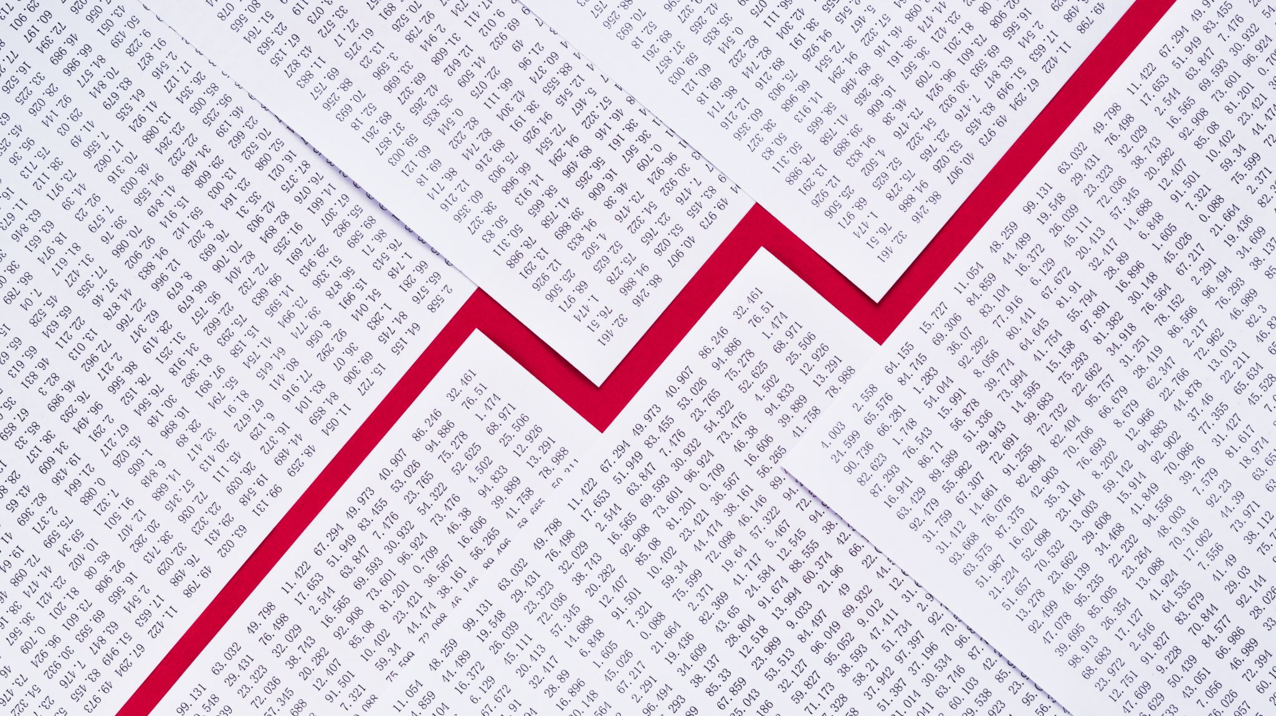
The Impact of COVID on the Stock Performance of FAANG Companies

Slide 8
Focus on
Price Trends
Trading Volumes
Comparison of Market Cap
Pre-pandemic
During pandemic
Post-pandemic

Slide 9
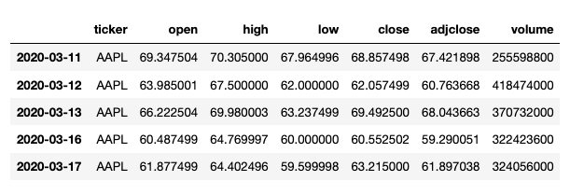
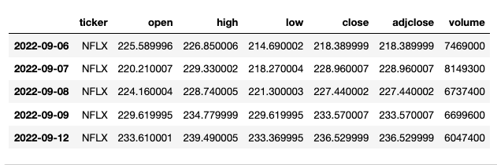
Covid dataset
The COVID period from March 11, 2020, to September 12, 2022, is represented using daily intervals to analyze the FAANG stock prices.

Slide 10
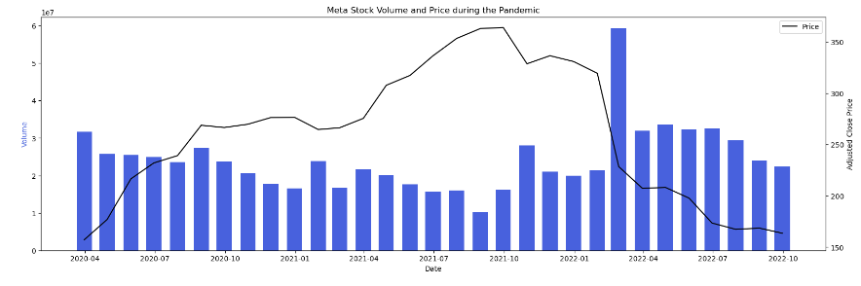
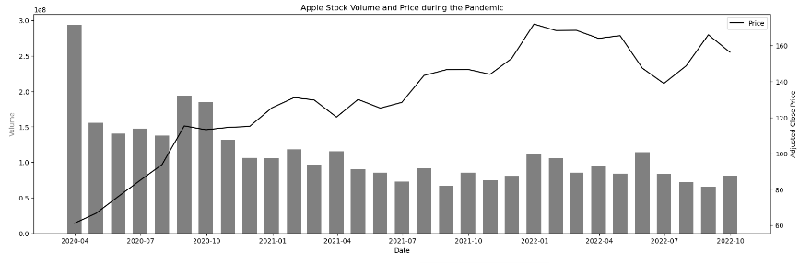
PRICE TRENDS & TRADING VOLUMES
Notes:
Resample the data for more clear visualization

Slide 11
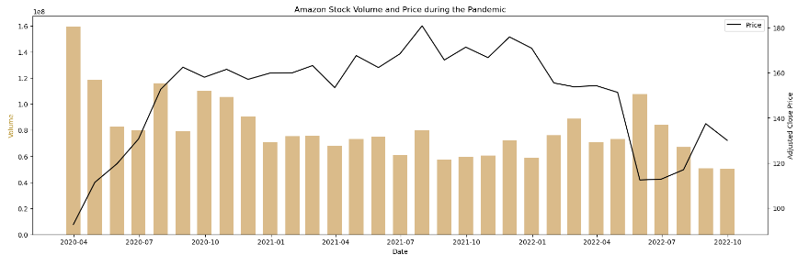
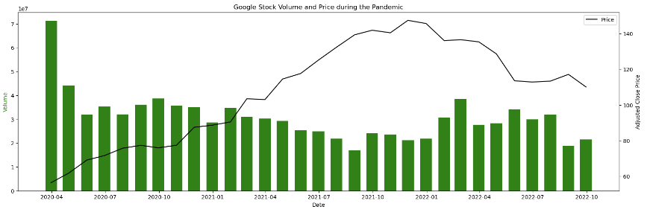
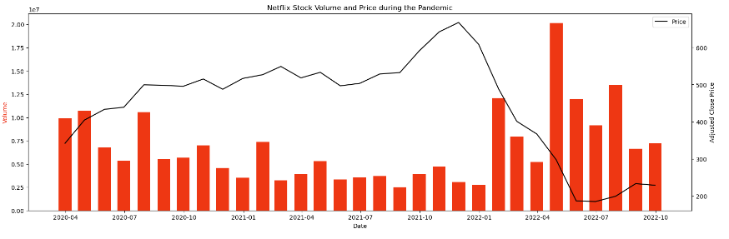
FAANG stocks initially dropped during the pandemic, except for Netflix. They later recovered, reflecting investor confidence.

Slide 12
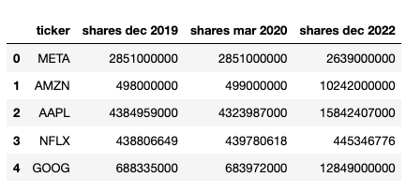
Share Data
Outstanding share data:
Pre-Pandemic (December 2019)
Pandemic (March 2020)
Post-Pandemic (December 2022)
Notes:
To calculate market cap

Slide 13
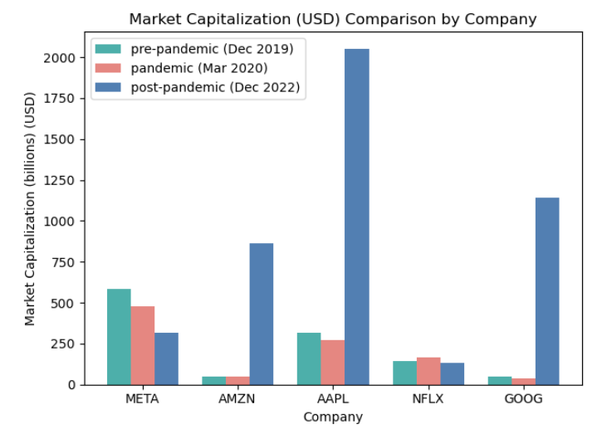
Calculating & comparing Market Cap
Multiplying Share Data with Stock Prices
During COVID Netflix Holds Strong
Amazon, Google, and Apple Stage Impressive Recovery in Post-COVID Era
Notes:
Multiplying Share Data with Stock Prices during Pre-Pandemic, Pandemic, and Post-Pandemic Periods

Slide 14
Comparison of S&P 500 Index vs FAANG Stocks

Slide 15
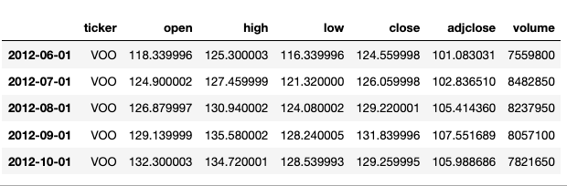
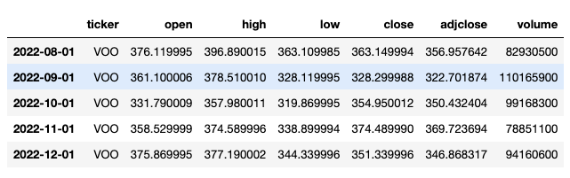
FECTCHING SP500 INDEX DATA
Utilizing the same interval and time span as the FAANG company data, the VOO ETF closely mirrors the performance of the S&P 500 Index.

Slide 16
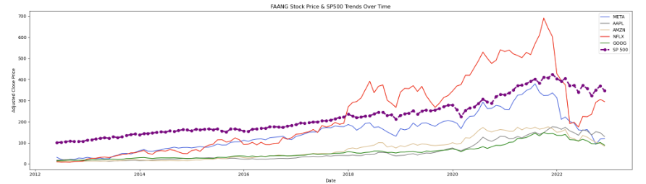
PRICE TRENDS COMPARSION
The S&P 500 Index demonstrated a consistent upward price trend like FAANG stocks over time.

Slide 17
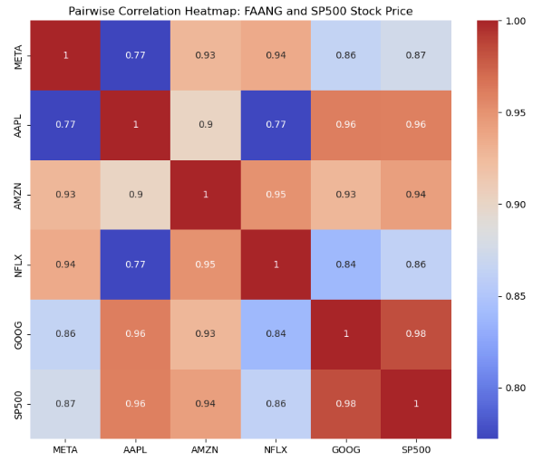
Correlation heatmap
Heatmap shows positive correlation between FAANG stocks and S&P 500, indicating a close relationship.

Slide 18
Summary
FAANG stocks demonstrate consistent price increases, making them attractive investments.
Apple, Google, and Amazon are relatively stable, while Netflix and Meta exhibit higher volatility.
FAANG stocks offer long-term growth opportunities with varying levels of risk and potential rewards based on individual preferences.

